Slide 1
HTD

Slide 2
Presentation
Nombre:
Ivan Adrian Chacon Monsreal
Contact:
IvanC3@hexaware.com

Slide 3
Getting Ready

Slide 4
Test Cases

Slide 5
1. Automate User Registration process of e-commerce website.
1. Open this url http://automationpractice.com/index.php
2. Click on sign in link.
3. Enter your email address in 'Create and account' section.
4. Click on Create an Account button.
5. Enter your Personal Information, Address and Contact info.
6. Click on Register button.
7. Validate that user is created.
2. Verify invalid email address error.
1. Open this url http://automationpractice.com/index.php
2. Click on sign in link.
3. Enter invalid email address in the email box and click enter.
4. Validate that an error message is displaying saying "Invalid email address."

Slide 6
3. Verify error messages for mandatory fields.
1. Open this url http://automationpractice.com/index.php
2. Click on sign in link.
3. Enter email address and click Register button.
4. Leave the mandatory fields (marked with *) blank and click Register button.
5. Verify that error has been displayed for the mandatory fields.
4. Verify error messages for entering incorrect values in fields.
1. Open this url http://automationpractice.com/index.php
2. Click on sign in link.
3. Enter email address and click Register button.
4. Enter incorrect values in fields like., enter numbers in first and last name, city field etc., and enter alphabets in Mobile no, Zip postal code etc., and click on 'Register' button.
5. Verify that error messages fpr respective fields are displaying.

Slide 7
5. 'Search Product' feature
1. Open link http://automationpractice.com/index.php
2. Move your cursor over Women's link.
3. Click on sub menu 'T-shirts'
4. Get Name/Text of the first product displayed on the page.
5. Now enter the same product name in the search bar present on top of page and click search button.
6. Validate that same product is displayed on searched page with same details which were displayed on T-Shirt's page.
6. 'Buy Product' feature
1. Open link http://automationpractice.com/index.php
2. Login to the website.
3. Move your cursor over Women's link.
4. Click on sub menu 'T-shirts'.
5. Mouse hover on the second product displayed.
6. 'More' button will be displayed, click on 'More' button.
7. Increase quantity to 2.
8. Select size 'L'
9. Select color.
10. Click 'Add to Cart' button.
11. Click 'Proceed to checkout' button.
12. Complete the buy order process till payment.
13. Make sure that Product is ordered.

Slide 8
7. Verify that 'Add to Wishlist' only works after login.
1. Open link http://automationpractice.com/index.php
2. Move your cursor over Women's link.
3. Click on sub menu 'T-shirts'.
4. Mouse hover on the second product displayed.
5. 'Add to Wishlist' will appear on the bottom of that product, click on it.
6. Verify that error message is displayed 'You must be logged in to manage your wish list.’
1. Go to http://automationpractice.com/index.php
2. Login to the website.
3. Move your cursor over Women's link.
4. Click on sub menu 'T-shirts'.
5. Mouse hover on the second product displayed.
6. 'More' button will be displayed, click on 'More' button.
7. Make sure quantity is set to 1.
8. Select size 'M'
9. Select color of your choice.
10. Click 'Add to Cart' button.
11. Click 'Proceed to checkout' button.
12. Change the quantity to 2.
13. Verify that Total price is changing and reflecting correct price.
8. Verify that Total Price is reflecting correctly if user changes quantity on 'Shopping Cart

Slide 9
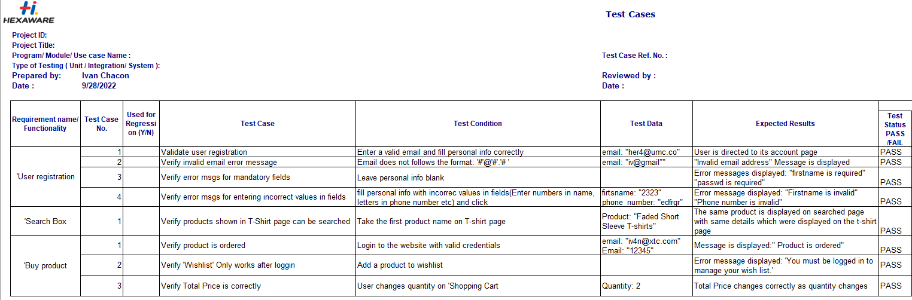
Test Cases

Slide 10
Framework Screenshot and explanation

Slide 11
Show Execution

Slide 12
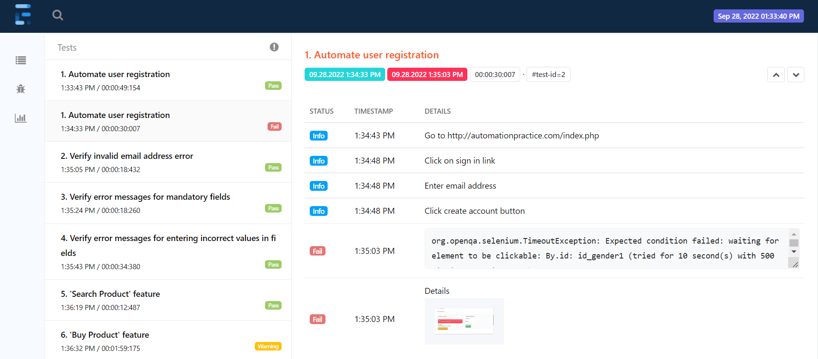
Show Report

